Slide 1
Accelerating DICe on an FPGA
Atiyeh Panahi, Keaten Stokke
Advisor: David Andrews

Slide 2
Thank You for Supporting this Project !
Atiyeh Panahi, Keaten Stokke
Advisor: David Andrews

Slide 3
Accomplishments to Date
HDL Implementation
Beta version nearly finished
Need guidance on data output format to complete last IP
FPGA inputs & outputs need to be established
Current system processing is about 1/100th to scale
Parameter/BRAM/etc scale up required to handle full image size and increased frame count
Core functionality complete. Not all DICe’s functionality accounted for yet
Not fully functional yet!

Slide 4
What We’ve Accomplished
Design
DICe software split into multiple IP’s
Each IP handles a specific function
Design Modularized to support future development
State machine structured IP’s
FSM’s enable more control over operations
Promotes better scalability and performance
Floating-point function improvements
Removed the “function” keyword; caused timing errors and constraints
Building functions as FSM’s yielded major clock speedup
Previous clock speed: <30 MHz; Current clock speed: 150 MHz

Slide 5
What We’ve Accomplished
MicroBlaze
The Xilinx soft processor is the powerhouse within the system
Global system controller
Allows introduction of operating system, middleware, device drivers
Helps to debug the system
AXI4 Lite Standard Bus
MicroBlaze controls the system-wide AXI4-Lite bus
Allows for processor control over each individual IP
Speeds up testing by bypassing other IP’s
Ethernet Driver
MicroBlaze will control the Ethernet that streams the FPGA’s inputs

Slide 6
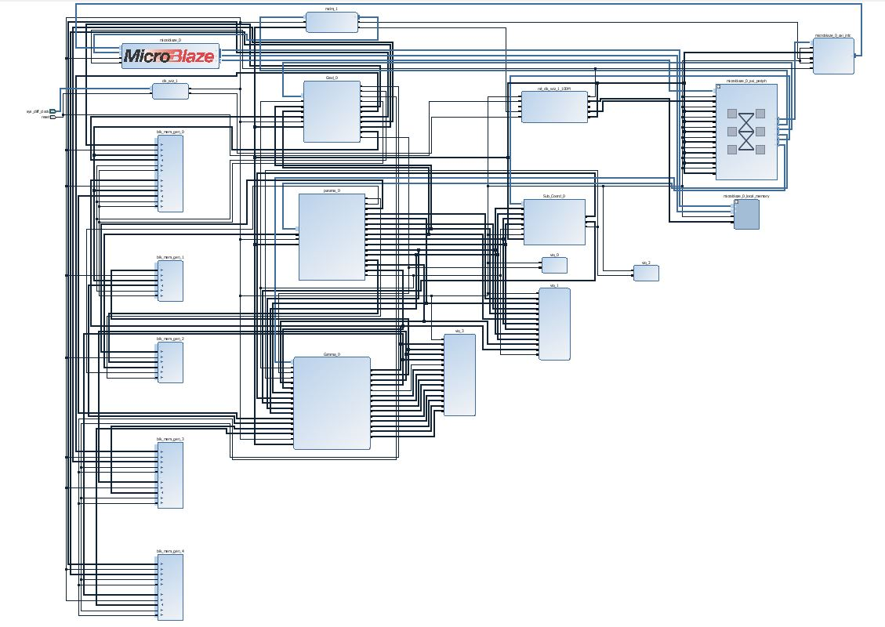
Vivado Block Design

Slide 7
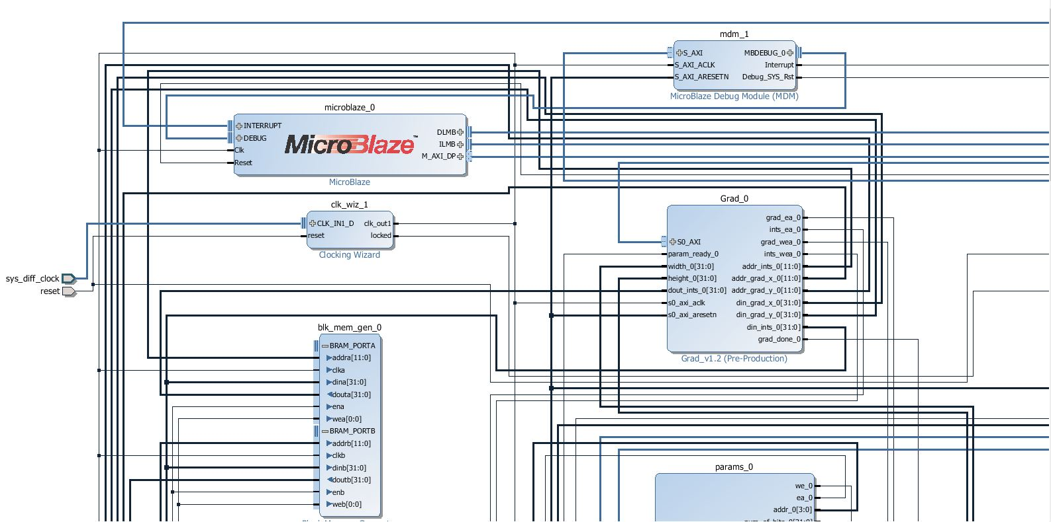
Vivado Block Design

Slide 8
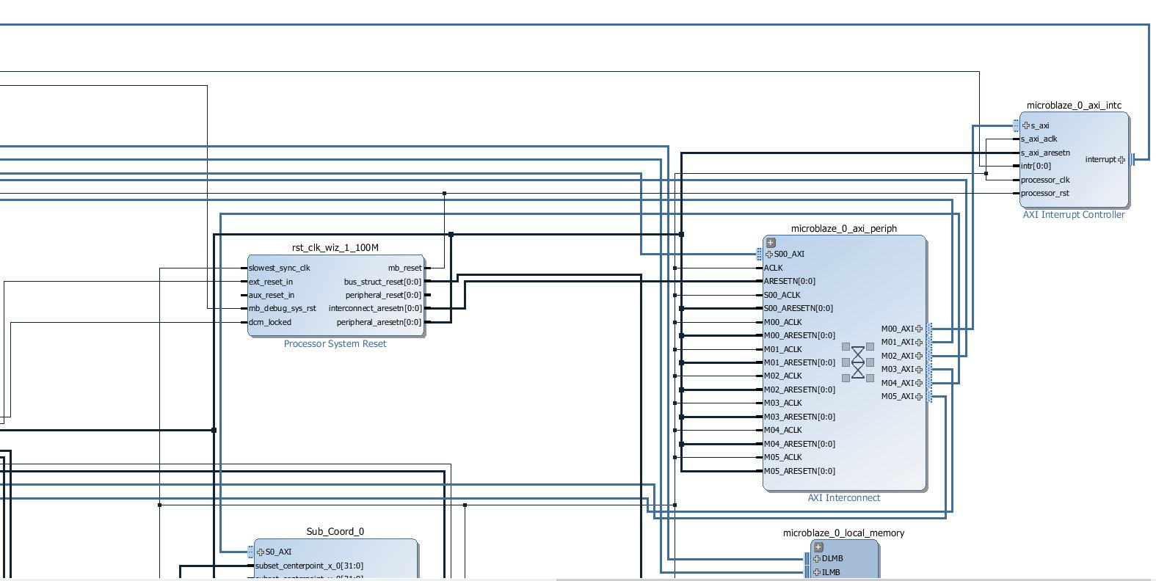
Vivado Block Design

Slide 9
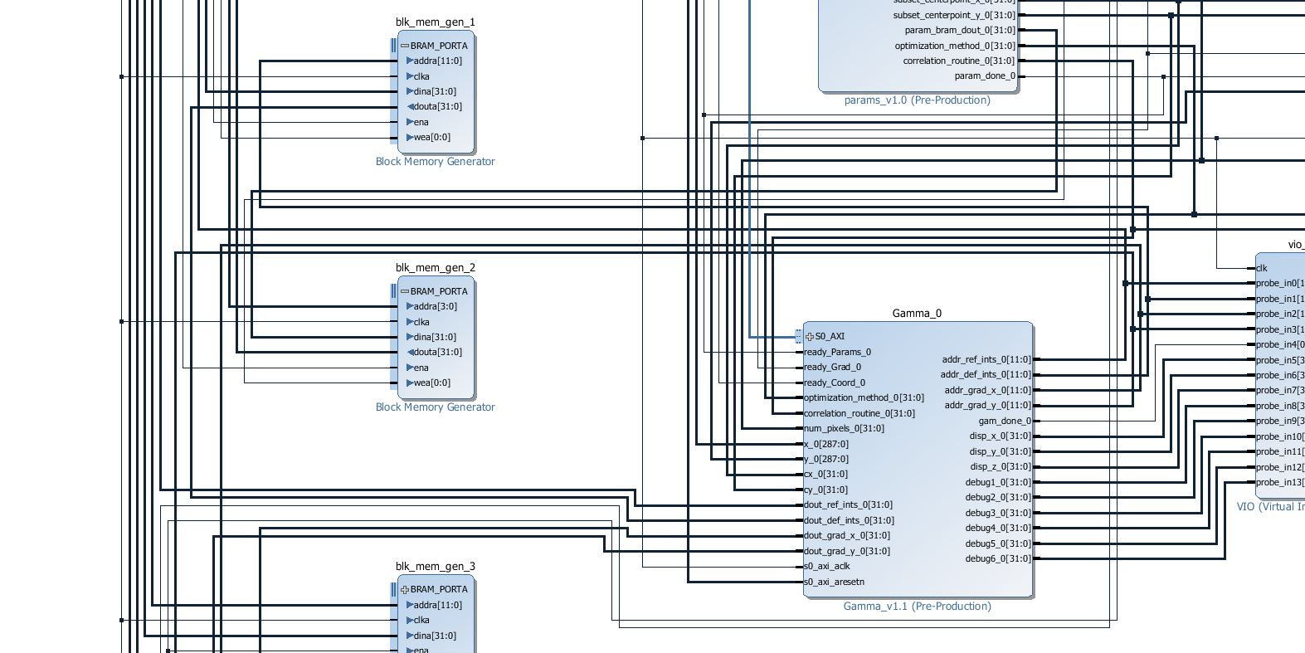
Vivado Block Design

Slide 10
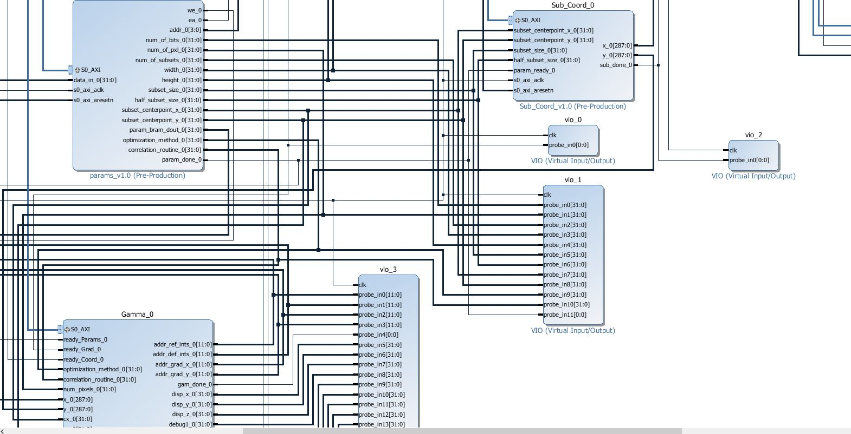
Vivado Block Design

Slide 11
Current Status
Design is working
Successful simulation and synthesis
Design meets timing constraints
Identical outputs are produced
Testing Data
Design compares just 2 frames
Used to verify IP functionality, buffers, end to end flow
Image size used (x1)
64*48 = 3,072 pixels, 98,304 bits at 32 bits per pixel (IEEE format)
Actual image size needed (x100)
640*480 = 307,200 pixels, 9,830,400 bits at 32 bits per pixel (IEEE format)
Scaling now only requires parameter changes, not to FSMs, system architecture

Slide 12


Results
Reference image VS. Deformed image
HDL VS. GUI - Execution time comparison
Linear growth expected!
Testbench | Frequency | HDL Exe Time | DICe Exe Time
64*48 – BRAM | 100 MHz | 3.5 ms | 13 ms/ 58 ms
64*48 – BRAM | 150 MHz | 2.5 ms | 13 ms/ 58 ms

Slide 13
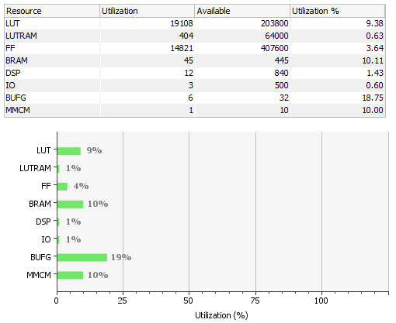
Results
Resource Utilization
Reports from 150 MHz design

Slide 14
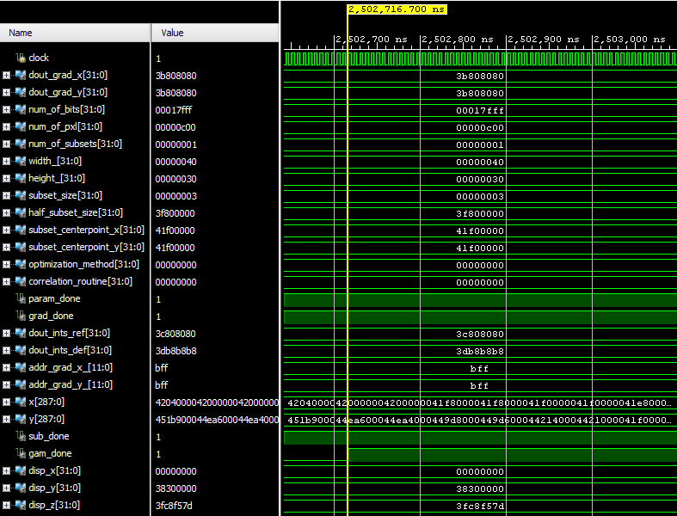
Results
Simulation Waveforms

Slide 15
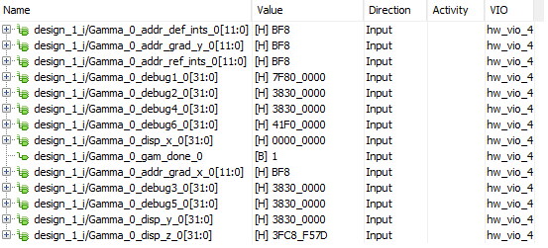
Results
Synthesis Waveforms

Slide 16
Demo
Let’s show you some of our work in Vivado!

Slide 17
Next Steps
Full-scale DICe HDL
Scale up BRAM sizing (x100)
Expecting images of 640*480 = 307,200 pixels
Handle a much larger frame count
Extend Functionality
Ability to have multiple subsets (currently just 1)
Handle various subset shapes (based on required needs)
Network I/O
Python program to intermediate (start, video conversion, FPGA communication)
Ethernet IP/Drivers to stream images
Desired output type? Text file?

Slide 18
Next Steps
Optimization & Performance
Memory and resources
Reduce memory and resource usage to account for design scale-up
Increased clock speed
Current design operates at 150 MHz
Potential to increase clock speed to 200 MHz
System-wide speed-up
Leverage ability to parallelize multiple IP’s
Implement various pipelining techniques
Compare HDL and HLS results for efficiency
Clean up
Improve readability of Verilog code
Will enable ease of future development

Slide 19
Questions From Us…
Are square subsets okay, or are unique subset shapes required?
Can we assume we will be sticking with black & white video?
Do you want us to set up a GitHub repository of our work and share the link to monitor progress?
Would it be possible to get a screen-recorded video of how your teams use the DICe software on some sample video, along with the total execution time?
I/O specifics for the FPGA

Slide 20


Questions For Us?

